Slide 1
Understanding Queues in Data Structures

Slide 2
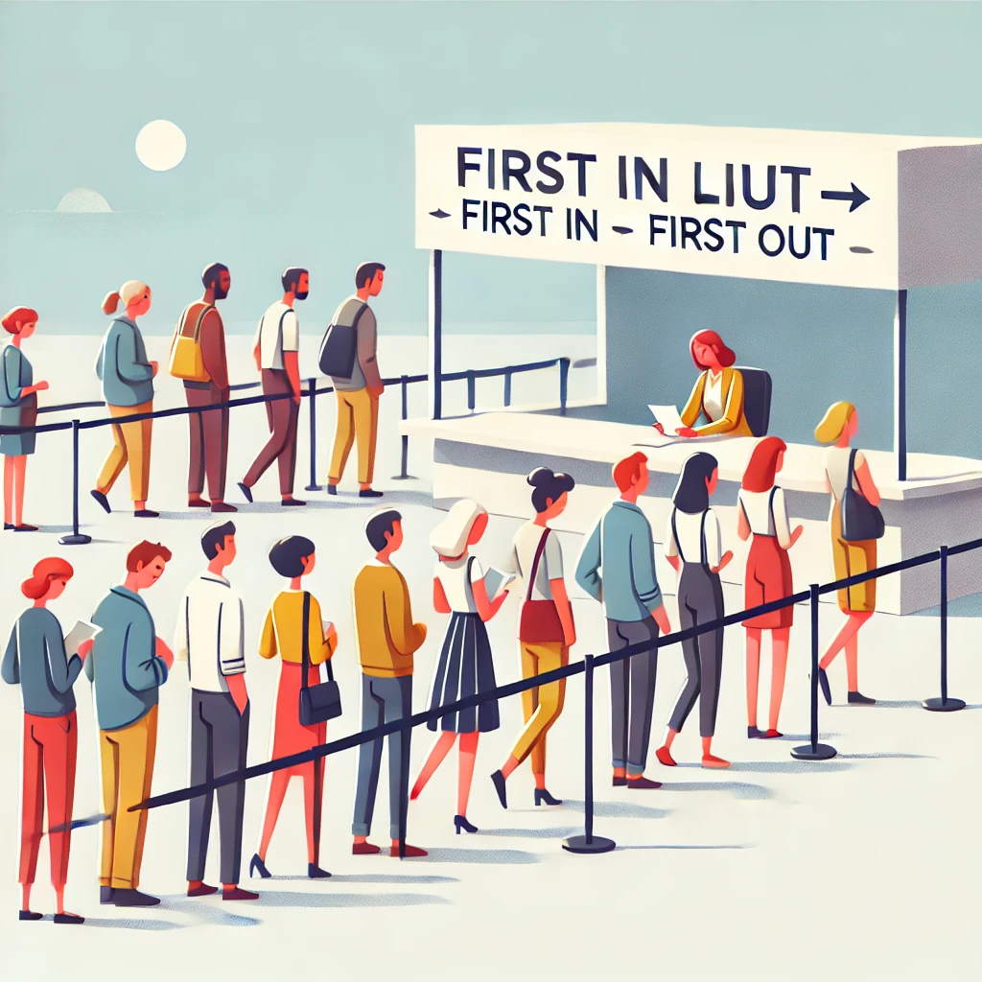
What is a Queue?
A queue is like a line of people waiting to buy tickets.
The first person to get in line is the first person who buys a ticket and leaves the line.
Just like this, in a queue, the first item that gets added is the first one to come out.

Slide 3
Basic Operations in a Queue
A queue has four main operations:
Enqueue
Dequeue
Peek
IsEmpty

Slide 4
Enqueue Operation
Enqueue Operation in a Queue: Think of a queue like lining up for ice cream. If Raj, Sima, and Anu are already in line, and you join, you stand at the end.
Here's how it looks:
Raj is at the front, and you are at the end.
In the queue, you always join at the end and wait your turn.
This way, the first person in line gets served first.

Slide 5
Enqueue Operation
Enqueue Operation in a Queue Continues..
This process, where everyone joins at the end of the line and waits for their turn, is what we call the "enqueue" operation in a queue.
It keeps things fair, making sure that the first one to join the line is the first one to be served.

Slide 6
Dequeue Operation
Using the ice cream line example, let's say Raj, Sima, Anu, and you are in line.
When the ice cream shop starts serving, Raj, who is at the front, gets his ice cream and leaves the line.
Now Sima is at the front.
This process of the first person leaving the line is called the "dequeue" operation in a queue. It means the first person in line gets served and moves out, making the next one the new front.

Slide 7
Peek/Front Operation
Peek/Front Operation in a Queue: Raj, Sima, Anu, and you are waiting.
If you want to know who's at the front of the line without anyone leaving, you just look to see it's Raj.
This action of looking at the front of the line without removing anyone is called the "peek" or "front" operation in a queue. It lets you see who's next to be served without changing the order.

Slide 8
Is Empty Operation
IsEmpty Operation in a Queue: In the ice cream line example with Raj, Sima, Anu, and you, if everyone gets their ice cream and leaves, no one is left in line.
If you look at the line to see if anyone is there and see it's empty, that's the "IsEmpty" operation in a queue.
This operation checks if there's anyone left in line. In this case, if the line is empty, no one is waiting, and it confirms that everyone has been served.

Slide 9
Real World Examples
Line at a Ticket Counter: People wait in line for tickets. The first person in line is served first, and new people join at the end.
Bus Stop Queue: People waiting for a bus form a line. The first person to arrive boards the bus first, and others wait their turn.
Printing Documents: When you send multiple documents to a printer, they are printed in the order they were sent—first document first.

Slide 10
Real World Examples
Call Center Management: Calls to a customer service center are handled in the order they arrive. The first caller is attended to first.
Amusement Park Rides: People waiting for a ride stand in a line. The person who joins first gets on the ride first.

Slide 11
Solving Problems with Queues - Managing Tasks
Problem: Manage a series of tasks using a queue to ensure they are handled in the order they arrive.
Solution: Show how tasks can be efficiently managed by enqueueing and dequeueing them as they are completed or started.

Slide 12
Solving Problems with Queues - Handling Calls
Problem: Simulate handling calls in a call center using a queue.
Solution: Describe step-by-step how calls are added to the queue and removed as they are answered.

